Slide 1

CS 2110 - Lab 18
Malloc Implementation and Q&A
Wednesday 4/20/2022

Slide 2
Homework 10 – Malloc Implementation
Write your own implementation of malloc and free!
Released Monday 4/18
Due Next Tuesday 4/26 at 11:59 PM
Files available on Canvas
Submit on Gradescope (unlimited submissions)
Standard grace period applies
Extensions for non-emergency/non-medical reasons are not possible on HW9 or HW10.

Slide 3
Final Review Lab
Next Monday 4/25 during lab
Review of the whole course before the final
You do not want to miss this lab

Slide 4
CIOS is open!
Please fill it out! Your feedback is extremely useful for improving the course
http://gatech.smartevals.com (or linked in Canvas)
Don't ask about a CIOS Bonus yet! If we decide to do a CIOS incentive, it will be announced via Canvas at a later date.

Slide 5
A Note from Shawn Wahi
Hello!
If you have time and motivation, please consider filling out CIOS for me too. Historically the Head TA gets significantly less CIOS comments compared to lab TAs. Since CIOS is fully anonymous, feel free to provide an honest comments (positive or negative). Let me know what things I did well and what areas you feel I need to improve upon. I'll be sure to read every comment I receive during Summer Break, while sipping on a Grande Iced Brown Sugar Oatmilk Shaken Espresso from Starbucks :)
- Shawn Wahi

Slide 6
Thank a Teacher
Let your TA or professor know that they did an outstanding job!
Help them get a sense of the positive impact they’ve had on your learning this semester ☺
http://thankateacher.gatech.edu

Slide 7
Review

Slide 8
What do we need to do?
Our implementation of the malloc library must:
Give out free memory as requested
Take memory back when it’s freed
Request more free memory from the operating system when we don’t have enough
We keep track of our memory in the freelist.

Slide 9
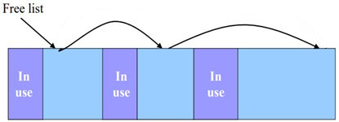
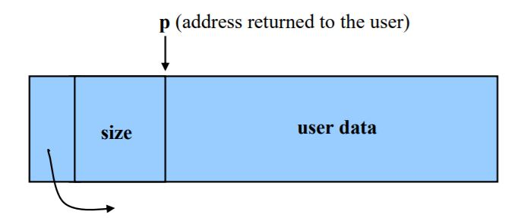
The Freelist!
The freelist is a linked list of blocks that are free (i.e. not in use)
Each block has metadata
Size of the block
Pointer to the next node

Slide 10
Basic Malloc Implementation
When the user calls malloc:
User asks for block of certain size
​​malloc looks through freelist for this size
If we find such a block, remove it from the freelist and return it to the user!
Otherwise, we split a larger block up, or request more space using sbrk

Slide 11
More on Malloc

Slide 12
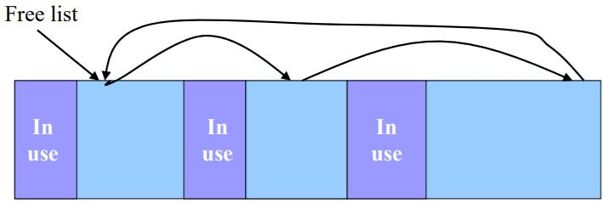
Matching
100
40
60
If the user requests 60 bytes of space, which block should be returned?
The “best match” choice is to return the last block, but this requires iterating through the whole list to see that it exists
Another option would be to do a “first match”—we could split the block of 100 into blocks of 40 and 60

Slide 13
Homework 10 Implementation
Our freelist is a singly-linked, non-circular linked list
Blocks are ordered by memory address
i.e., the first node in the linked list will be the block starting at the lowest address
“Best match”—we will always iterate through the freelist until we find a block of the correct size

Slide 14
Free Semantics
100
40
60
20
What if the user were to free the block of size 20?
We might end up with three adjacent blocks (40, 20, 60)—what if the user then requests 120 bytes?
Solution: we should merge these nodes after freeing
How can we tell if two nodes are adjacent?
Hint: our freelist is ordered by memory address

Slide 15
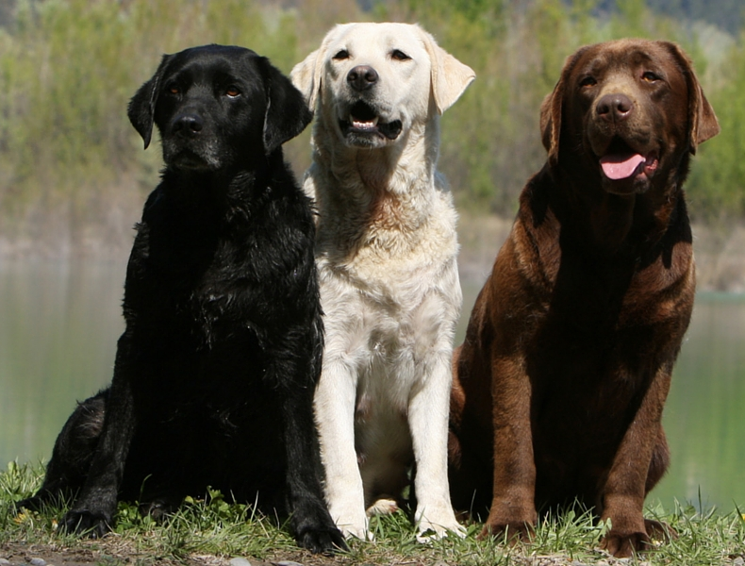
Lab Assignment: Canvas Quiz
Go to Quizzes on Canvas
Select Lab 18
Access code: press_f_for_canaries
Get 100% to get checked off!
Unlimited attempts
Collaboration is allowed!
Ask your TAs for help :)

